Slide 1
NASA Space Apps 2021
Problem statement - Leveraging AI/ML for plastic marine debris
Solution - Aegir: Locating, detecting and classifying of ocean debris made easier using AI
Team - Kludge Protocol Akash James
Aastha Singh
Shubham Baid

Slide 2
Content
Literature Survey
Time-Series analysis of satellite plastic debris data.
Identification, Classification and Density analysis of Plastic debris from high resolution UAV cameras.
Community/Authority Empowerment.

Slide 3
Literature Review
Over 300 million tonnes of plastic gets produced every year and at least 8 million tonnes ends up in our ocean. Marine species ingest or are tangled by plastic debris which causes severe injuries and deaths. Plastic pollution threatens food safety and quality, human health, coastal tourism, and contributes to climate change.
Scientists are using satellites to detect and track plastic debris from Satellite,The scientists conducted this research on images provided by the satellite sentinel-2 and used a metric called FDI(Floating Debris Index) to measure the same with the accuracy rate of 86%, however the data is not easily understandable by general public.
The Ocean Cleanup, a Non-profit Organisation focused towards cleaning up the Ocean has been continuously contributing towards removal of plastric debris from ocean. They aim to remove 90% of the plastic from the Ocean using their technology and community support.

Slide 4
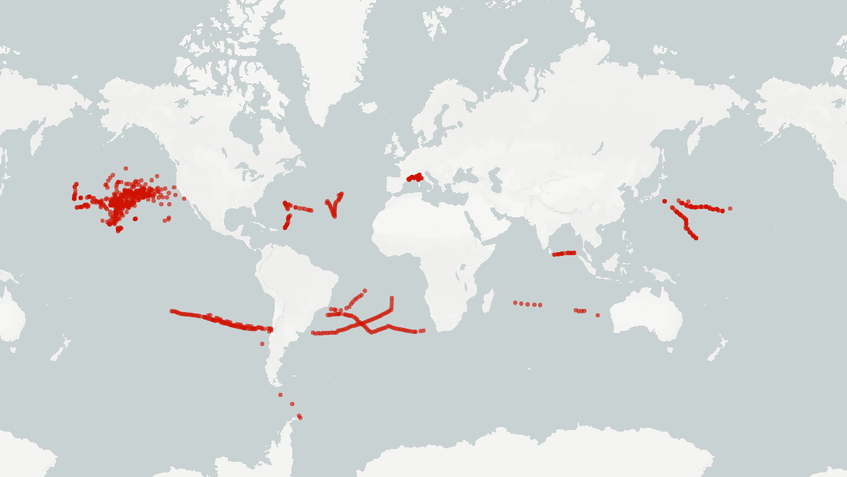
Time series analysis of satellite plastic debris data
Data collected from NOAA and The Ocean Cleanup Project were used for time-series prediction and analysis of debris flow across the ocean.
Density and weight of debris, ocean currents, wind patterns and tides were considered for this
Time-series enables future lat-long prediction of garbage patches, that can help improve clean up missions and volunteering activities

Slide 5
Identification, Classification and Density analysis of Plastic debris from high resolution UAV cameras
Data collected from HAIDA and THe Ocean Cleanup was used to train the model for identification, classification and density analysis for plastic debris from UAV cameras.
YOLOX an anchor-less object detection is used for this task and EfficientNet is used as a regression model to generate density information and showcased it using heatmaps
The models are optimised with TensortRT and hence are ready to deploy on embedded systems as well as workstations.
The models are served on our gunicorn/flask server so it can be accessed by drone, community applications e.t.c

Slide 6

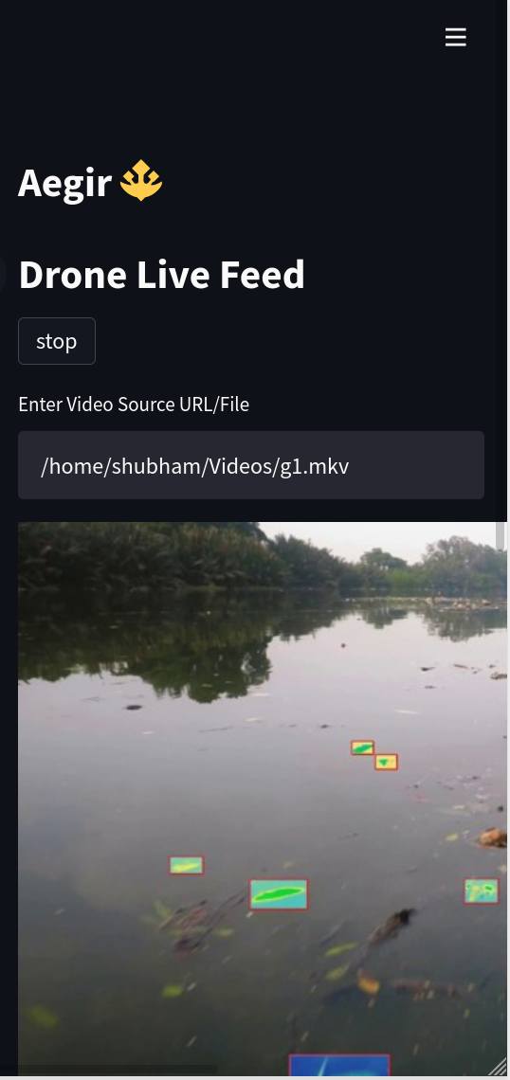
Community/Authority empowerment
We've seen various community efforts being organised in order to clean our oceans and other water bodies. We planned on automating this using Twitter. When the debris would be sufficiently close to coastal regions, our system would automatically shoot our tweets to initiate community events that would help with our fight against pollution!
Being a part of the community, users can use our platform to report debris accumulation.

